Slide 1
CREATION
in scripture

Slide 2
Creation Creating Co-creating Procreation Creativity

Slide 3
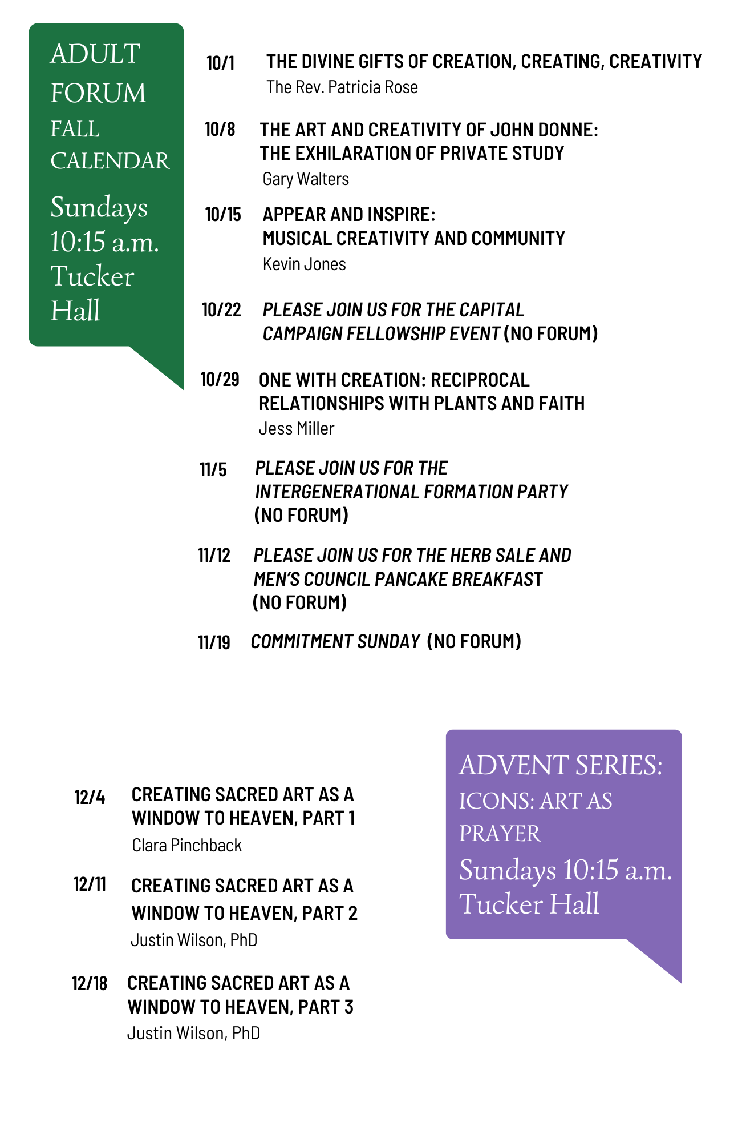
Fall Forum

Slide 4
How does it speak to you? What aspect of creation do you relate it to? What value does it offer you in your day to day living?

Slide 5
In the beginning the earth was a formless void and darkness covered the face of the deep, while the spirit of God swept over the face of the waters. Then God said, “Let there be light” and there was light. Gen 1:1-3
At Contoso, we believe in giving 110%. By using our next-generation data architecture, we help organizations virtuallmanage agile workflows. We thrive because of our market knowledge and great team behind our product. As our CEO says, "Efficiencies will come from proactively transforming how we do business."

Slide 6
I am the Lord, your Holy One, the Creator . . . Do not remember the former things, or things of old. I am about to do a new thing; now it springs forth. Do you not perceive it? Isaiah 43:15,19

Slide 7
Make a joyful noise to the Lord, all the earth; break forth into joyous song and sing praises. Psalm 98:4

Slide 8
Ask the animals, and they will teach you, or the birds of the air, and they will tell you; or speak to the earth, and it will teach you, or let the fish of the sea inform you. Job 12:7

Slide 9
“For we are God’s handiwork, created in Christ Jesus to do good works, which God prepared in advance for us to do.”
Ephesians 2:10

Slide 10
Do not worry about what you should say for the Holy Spirit will teach you at that moment what you should say. Luke 12:11-12

Slide 11
Proverbs 17:6
Grandchildren are the crown of their elders, and the glory of children is their parents.

Slide 12
The Lord has filled them with skill to do every kind of work done by an artisan or by a designer or by an embroiderer in blue, purple, and crimson yarns, and in fine linen, or by a weaver - by any sort of artisan or skilled designer. Exodus 35:35
”
“

Slide 13
John 1:1
In the beginning was the Word, and the Word was with God, and the Word was God.
-

Slide 14
Do not be conformed to this world, but be transformed by the renewing of your minds, so that you may discern what is the will of God - what is good and acceptable and perfect. Romans 12:2

Slide 15
. . . and you will know the truth, and the truth will make you free. John 8:32

Slide 16
The heavens declare the glory of God; the skies proclaim the work of God’s hands. Psalm 19:1

Slide 17
My lips will shout for joy, when I sing praises to you; my soul also, which you have redeemed. Psalm 71:23

